Slide 1
A History and Evaluation of System R

Slide 2
A History and Evaluation of System R
SUMMARY: System R, an experimental database system, was constructed to demonstrate that the usability advantages of the relational data model can be realized in a system with the complete function and high performance required for everyday production use. This paper describes the three principal phases of the System R project and discusses some of the lessons learned from System R about the design of relational systems and database systems in general.

Slide 3
Data independence: “immunity” of applications to change in storage structure and access strategy. (C.J. Date 1977)
Modern Systems: a high level user interface instead of bits pointers arrays lists etc. System is responsible for appropriate internal representation for information.
Relational data model was proposed by E.F. Codd in 1970
Codd’s observation: Systems store data in two ways
Contents of records stored in the database
The ways in which these records are connected together (links, sets, chains, parents etc.)

Slide 4
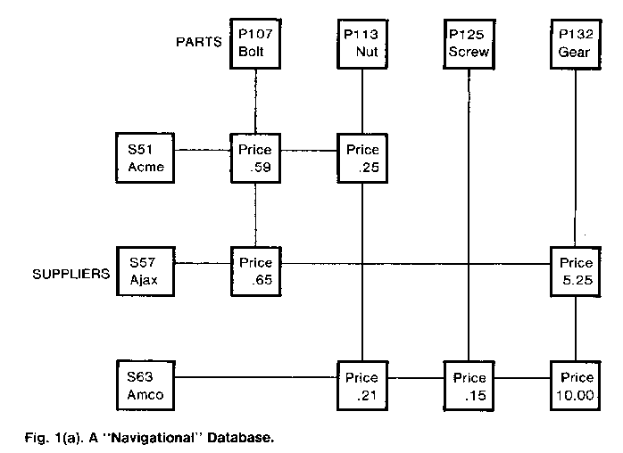
A Navigational Database

Slide 5
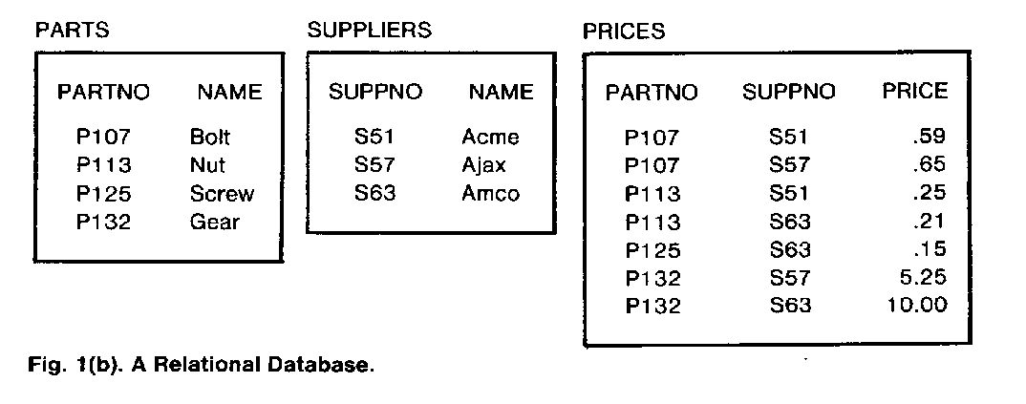
A Relational Database

Slide 6
What is the lowest price for bolts?
SELECT MIN(PRICE)
FROM PRICES
WHERE PARTNO IN
(SELECT PARTNO
FROM PARTS
WHERE NAME =‘BOLT’);

Slide 7
Key Goals
To provide a high-level non navigational user interface for maximum user productivity and data independence
To support different types of database use including programmed transactions, ad hoc queries and report generation
To support a rapidly changing database environment, in which tables, indexes, views, transactions and other objects could easily be added to and removed from the database without stopping the system

Slide 8
Key Goals
To support a population of many concurrent users, with mechanisms to protect the integrity of the database in a concurrent-update environment
To provide a means of recovering the contents of the database to a consistent state after a failure of hardware or software
To provide a flexible mechanism whereby different views of stored data can be defined and various users can be authorized to query and update these views
To support all of the above functions with a level of performance comparable to existing lower-function database systems

Slide 9
The History of System R can be divided into three phases:
Phase Zero(1974-1975):
Involved development of SQL interface and a quick implementation of a subset of SQL for one user at a time.
Provided valuable insight in several areas but its code was eventually abandoned.

Slide 10
The History of System R can be divided into three phases:
Phase One(1976-1977):
Involved design and construction of full function multiuser version of System R.
Phase Two(1978-1979): evaluation of Sytem R in actual use
Involved experiments at the San Jose Research Labratory and several other sites.

Slide 11
Phase Zero (1)
Uses relational access method called XRM
Since XRM is a single-user access method without locking or recovery capabilities, issues relating to concurrency and recovery were excluded.
Interpreter program in PL/I to execute statements in high-level SQL
SQL includes queries and updates of database as well as creation of new relations
Implementation contained “subquery” construct of SQL but not “join” construct

Slide 12
Phase Zero (2)
Intended for use as standalone query interface
Human factors aspects of SQL language (learnability and usability of SQL)
System Catalog was stored as a regular set of relations in the database itself
Phase zero was strongly influenced by the facilities of XRM.

Slide 13
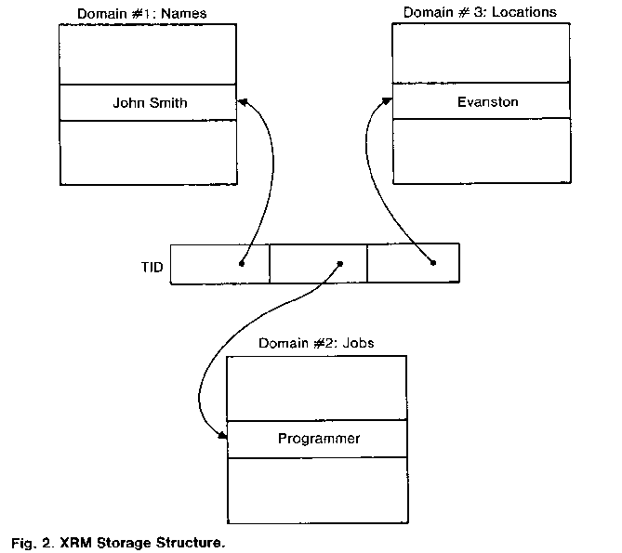
XRM Storage Structure
Stores relations as tuples
32 bit TID
TID contains a page #
Tuple contains pointers to the domains
Each domain may have an “inversion” (associated domain values with TIDs)
XRM uses the inversions
John Smith
Evanston
Programmer

Slide 14
Phase Zero (3)
The most challenging task in Phase Zero was the design of optimizer algorithms for efficient execution of SQL
The objective was to minimize the number of tuples fetched from the database in processing a query.
Therefore made extensive use of inversions and often manipulated TID lists.

Slide 15
Results of Phase Zero
It was a good idea to plan to throw away the first implementation
Demostrated usability of SQL language
Feasibility of new tables and inversions on the fly and relying on an automatic optimizer for access path selection
Convenience of storing the system catalog in the database itself

Slide 16
Lessons from Phase Zero (1)
The optimizer should take into account not just the cost of fetching tuples, but the costs of creating and manipulating TID lists.
“Number of I/Os” is a better cost of measure than “Number of tuples fetched”
Optimizer cost measure should be a weighted sum of CPU time and I/O count, weights adjustable according to system configuration.

Slide 17
Lessons from Phase Zero (2)
“join” formulation of SQL is very important.
The Phase Zero optimizer was quite complex and was oriented towards complex queries.

Slide 18
Phase One (1)
Access Method : Research Storage System (RSS)
SQL processor: Relational Data System (RDS)
RDS runs on top of RSS
RSS does locking and logging
RDS does authorization and access path selection
RSS was designed to support multiple concurrent users

Slide 19
Phase One (2)
Locking subsystem
View and Authorization subsystems
Recovery subsystem
Supports both PL/I and COBOL
VMCMS operating system
Standalone query interface of System R:
UFI (User Friendly Interface)

Slide 20
Compilation Approach
It is possible to compile very high-level SQL statements into compact efficient routines in System/370 machine language.
SQL statements of arbitrary complexity can be decomposed into a relatively small collection of machine language “fragments”
An optimizing compiler can assemble these to process a given SQL statement

Slide 21
Compilation Approach (2)
SQL statement optimized and compiled to machine code which are packaged to access modules.
When executed, access module performs all interactions with the database by means of calls to the RSS.
Overhead of parsing, validity checking and access path selection is removed from executing program and is done in a separate preprocessor step.

Slide 22
Compilation Approach (3)
Possibility that subsequent changes in database may invalidate some decisions in an access module.
Dependencies on database objects (tables, indexes) are recorded for each access module in system catalog
If the structures invalidatea an access module, it is regenerated from its original SQL statements.
Ad hoc queries coming from UFI are also converted to machine-language routines, which are executed the same way as access modules

Slide 23
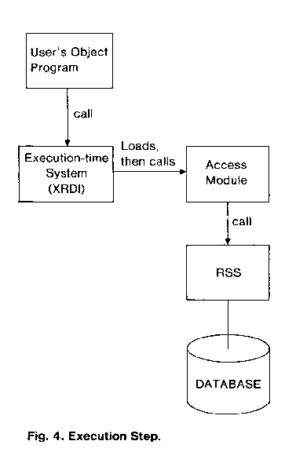
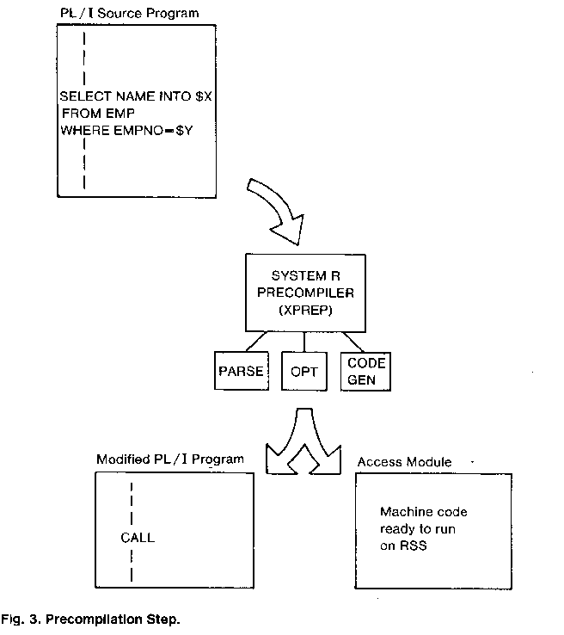
Compilation and Execution

Slide 24
RSS Access Paths
RSS stores data values in individual records
Records become variable in length and longer on the average than XRM records.
All data of a record is fetched in single I/O
In place of “inversions” RSS provides “indexes” implemented in form of B-Trees.
RSS also implements “links”

Slide 25
RSS Access Paths (2)
Index scans (value order)
Relation scans (physical order)
Link scans (from record to record)
Search arguments can be specified, which limit the number of records returned
RSS also provides a built in sorting mechanism, which can sort scan results.

Slide 26
The Optimizer
Designed to minimize the weighted sum of the predicted number of I/Os and RSS calls in processing an SQL statement
Uses indexes instead of TID lists
The access path choice is based on the optimizers estimate of both the clustering and selectivity properties of each index

Slide 27
The Optimizer (2)
Technique of performing joins originate from a research made on 10 methods
Nearly optimal 2 methods were:
Scan over the qualifying rows of tableA, for each row, fetch the matching rows of table B
Sort the qualifying rows of Tables A andB in order by their respective join fields. Then scan over the sorted lists and merge them by matching values

Slide 28
Views and Authorization
Objective: power and flexibility
Any SQL query to be used as definition of a view
View definitions stored in form of SQL parse trees
Operation parse tree merged with view parse tree, when an SQL operation is to be executed against a view.
View can be updated only if it is derived from a single table in the database

Slide 29
Views and Authorization (2)
Based on priveleges controlled by the SQL statements GRANT and REVOKE
Each user can be given RESOURCE privelege, which enables him to create new tables in DB.
Creator receives access,update and destroy priveleges on that table
The creator can then grant these priveleges to other people
Each granted privilege may optionally carry with it the “GRANT” privelege
REVOKE destroys whole chain of granted priveleges.

Slide 30
Recovery
Objective: provision of a means whereby the database may be recovered to a consistent state in the event of a failure.
Media failure: information on disk is lost
image dump of the database plus a log of “before” and “after” changes provide the alternate copy which makes recovery possible.
Use of “dual logs” even permits recovery from media failures on the log itself

Slide 31
Recovery (2)
System failure: information in main memory is lost.
System R uses change log plus “shadow pages” to recover from system failure.
Transaction failure: all changes made by the failing transaction must be undone.
System R simply processes the change log backwards to remove all chages made by failed transaction.
Unlike media and system recovery, which both require that System R be reinitialized, transaction recovery takes place on-line.

Slide 32
Locking
The original design involved concept of “predicate locks” in which the lockable unit was a database property such as “employees whose location is Evanston”
Determining if two predicates are mutually satisfiable is difficult and time-consuming
Two predicates may appear to conflict, when in fact the semantics of the data prevent any conflict.
Desire to contain locking subsystem entirely within RSS thus make it independant of any understanding of predicates.

Slide 33
Locking (2)
The chosen scheme involves a hierarchy of locks, with several sizes of lockable units, ranging from individual records to several tables.
Locking subsystem is transparent to end-users, but acquires locks on physical objects in the database as they are processed.
When a user accumulates many small locks, they can be traded for a larger lockable unit.
When locks are acquired on small objects, “intention” locks are simultaneously acquired on the larger objects which contain them.

Slide 34
Phase Two: Evaluation
Evaluation phase lasted 2.5 years
Experiments performed on the system at the San Jose Research Laboratory
Actual use of the system at a number of internal IBM sites and at three selected customer sites.
At all user sites, System R was installed on an experimetal basis for study purposes only

Slide 35
General User Comments
Install system, design and load a database within days
System performance tuneable without impacting end users
Performance characteristics and resource consumption generally satisfactory
In general databases were smaller than one 3330 disk pack (200Mb) and were typically accessed by fewer than ten concurrent users.
Interactive response slowed down during execution of complex SQL statements involving joins of several tables

Slide 36
The SQL Language
Successful in achieving its goals of simplicity, power and data independence
Users without prior experience were able to to learn a usable subset on their first sitting.
As a whole the language provided the query power of the first order predicate calculus combined with operators for grouping arithmetic and built-in functions such as SUM and AVERAGE

Slide 37
The SQL Language (2)
Users praised the uniformity of the SQL syntax across the environments of application programs, ad hoc query, and data definition.

Slide 38
Implemented User Suggestions
Easy to use syntax for existence or non existence of data item: “EXISTS”
Searching for partially known strings: “LIKE”
Requirement for computing and SQL statement dynamically, submit statement to optimizer for access path selection, then execute the statement repeatedly for different data values without reinvoking the optimizer: “PREPARE” and “EXECUTE” statements in host-language version of SQL.
Need for “outer join” facility for SQL.

Slide 39
The Compilation Approach
The approach of compiling SQL statements into machine code was one of the most successful parts of the project
A machine language routine was generated to execute any SQL statement of arbitrary complexity by selecting code fragments from a library of approximately 100 fragments.

Slide 40
The Compilation Approach (2)
For short, repetitive transactions, the benefits are obvious: most overhead is removed.
In ad hoc query environment the advantages of compilation are less obvious as query is executed only once.
Final advantage is its simplifying effect on system architecture. (ad hoc queries and precanned transactions being treated the same way)

Slide 41
Available Access Paths
The principal access path used for retrieving data associatively by its value is B-Tree index.
Hashing and direct links techniques were not used.
Hashing and links would have enhanced the performance of “canned transactions” which only access a few records.
For transactions which retrieve a large set of records, the additional I/Os caused by indexes are less important.

Slide 42
The Optimizer
A series of experiments were conducted to evaluate the success of System R optimizer.
Optimizer was modified to generate every possible access path, and to estimate cost of each path.
A Mechanism was added to force execution of an SQL statement by a particular access path and measure actual number of page fetches and RSS calls.

Slide 43
The Optimizer (2)
Although optimizer was able to correctly order the access paths, magnitudes of predicted costs differed from measured costs in several cases.
Cause: inability to predict how much data would remain in system buffers during sorting.
The experiments conducted do not address the issue, whether or not a very good access path for a given SQL statement might be overlooked.

Slide 44
Views and Authorization
Users generally found Mechanisms for defining views and controlling authorization to be powerful, flexible and convenient.
Beneficial features:
- Full query power of SQL is made available for defining new views
- The authorization system allows each installation of System R to choose “fully cenralized”, “fully decentralized” or an intermediate policy.

Slide 45
Views and Authorization (2)
Following suggestions were made to improve:
Authorization subsystem could be augmented by the concept of a “group” of users
A new command could be added to SQL language to change the ownership of a table from one user to another.
Occasionally it is necessary to reload an existing table in the database (e.g to change its physical clustering properties) While doing this views and authorizations defined on the table are lost) It was suggested that views and authorizations be held “in abeyance” pending reactivation of the table.

Slide 46
The Recovery Subsystem
The combined “Shadow page” and log mechanism used in System R proved to be quite successful.
Keeping of shadow pages for each updated page had a big impact on system performance due primarily to the following factors:

Slide 47
The Recovery Subsystem (2)
Each updated page is written to a new location on disk, the ability of the system to cluster related pages in secondary storage to minimize disk arm movement is limited.
Since each page can be an “old” and “new” version, a directory must be maintained to locate each version
The periodic checkpoints which exchange the “old” and “new” pointers generate I/O activity and consume certain amount of CPU time.

Slide 48
The Recovery Subsystem (3)
Possible alternative is to dispense with the concept of shadow pages and simply keep a log of all database updates.
Mechanisms can be developed to minimize I/Os by retaining updated pages in the buffers until several pages are written out at once, sharing an I/O to the log.

Slide 49
The Locking Subsystem
The locking subsystem provides each user with a choice of three levels of isolation from other users.
Under no circumstances can a transaction at any isolation level, perform updates on the uncomitted data of another transaction.
Level 1: may read but not update uncommitted data
Level 2: transaction is protected from reading uncommitted data.
Level 3: Transaction is guaranteed that successive reads of the same record will yield same value.

Slide 50
The Locking Subsystem (2)
Level 1 should have provided very quick scans through the database, when approximate values were acceptable.
It was expected that a tradeoff would exist between levels 2 and 3. Where level 2 would eb “chaper” and level 3 would be “safer” (In practice Level 3 involved less CPU overhead)
As a result of the observations, most users ran their queries and application programs at level 3, which was the system default.

Slide 51
The Convoy Phenomenon
Experiments with the locking subsystem of System R identified a problem which came to be known as the “convoy phenomenon”
The solution to the convoy problem involved a change to the lock release protocol of System R.

Slide 52
Additional Observations
When running in a “canned transaction” environment it would be helpful for the system to include a data communications front end to handle terminal interactions, priority scheduling, and logging and restart at the message level.
When recovery subsystem attempts to take an automatic checkpoint, it inhibits the processing of new RSS commands until all users have completed their current RSS command, then checkpoint is taken and all users are allowed to proceed.

Slide 53
Additional Observations (2)
The System R design of automatically maintaining a system catalog as a part of the online database was very well liked by users.

Slide 54
Conclusions
System R demonstrated the feasibility of applying a relational database system to a real production environment in which many concurrent users are performing a mixture of ad hoc queries and repetitive transactions.
Relational data model can have a dramatic positive effect on user productivity in developing new applications.

Slide 55
Conclusions (2)
In particular, System R has demonstrated the feasibility of compiling a very high-level data sublanguage, SQL, into machine level code.
Major foci of the continuing research program are adaptation of System R to a distributed database environment and extension of the optimizer algorithms to encompass a broader set of access paths.

